Slide 1

Global Health in Numbers
A Statistical Dive into Life Expectancy (2000–2015)
Notes:
Photo by Sean Pollock on Unsplash

Slide 2
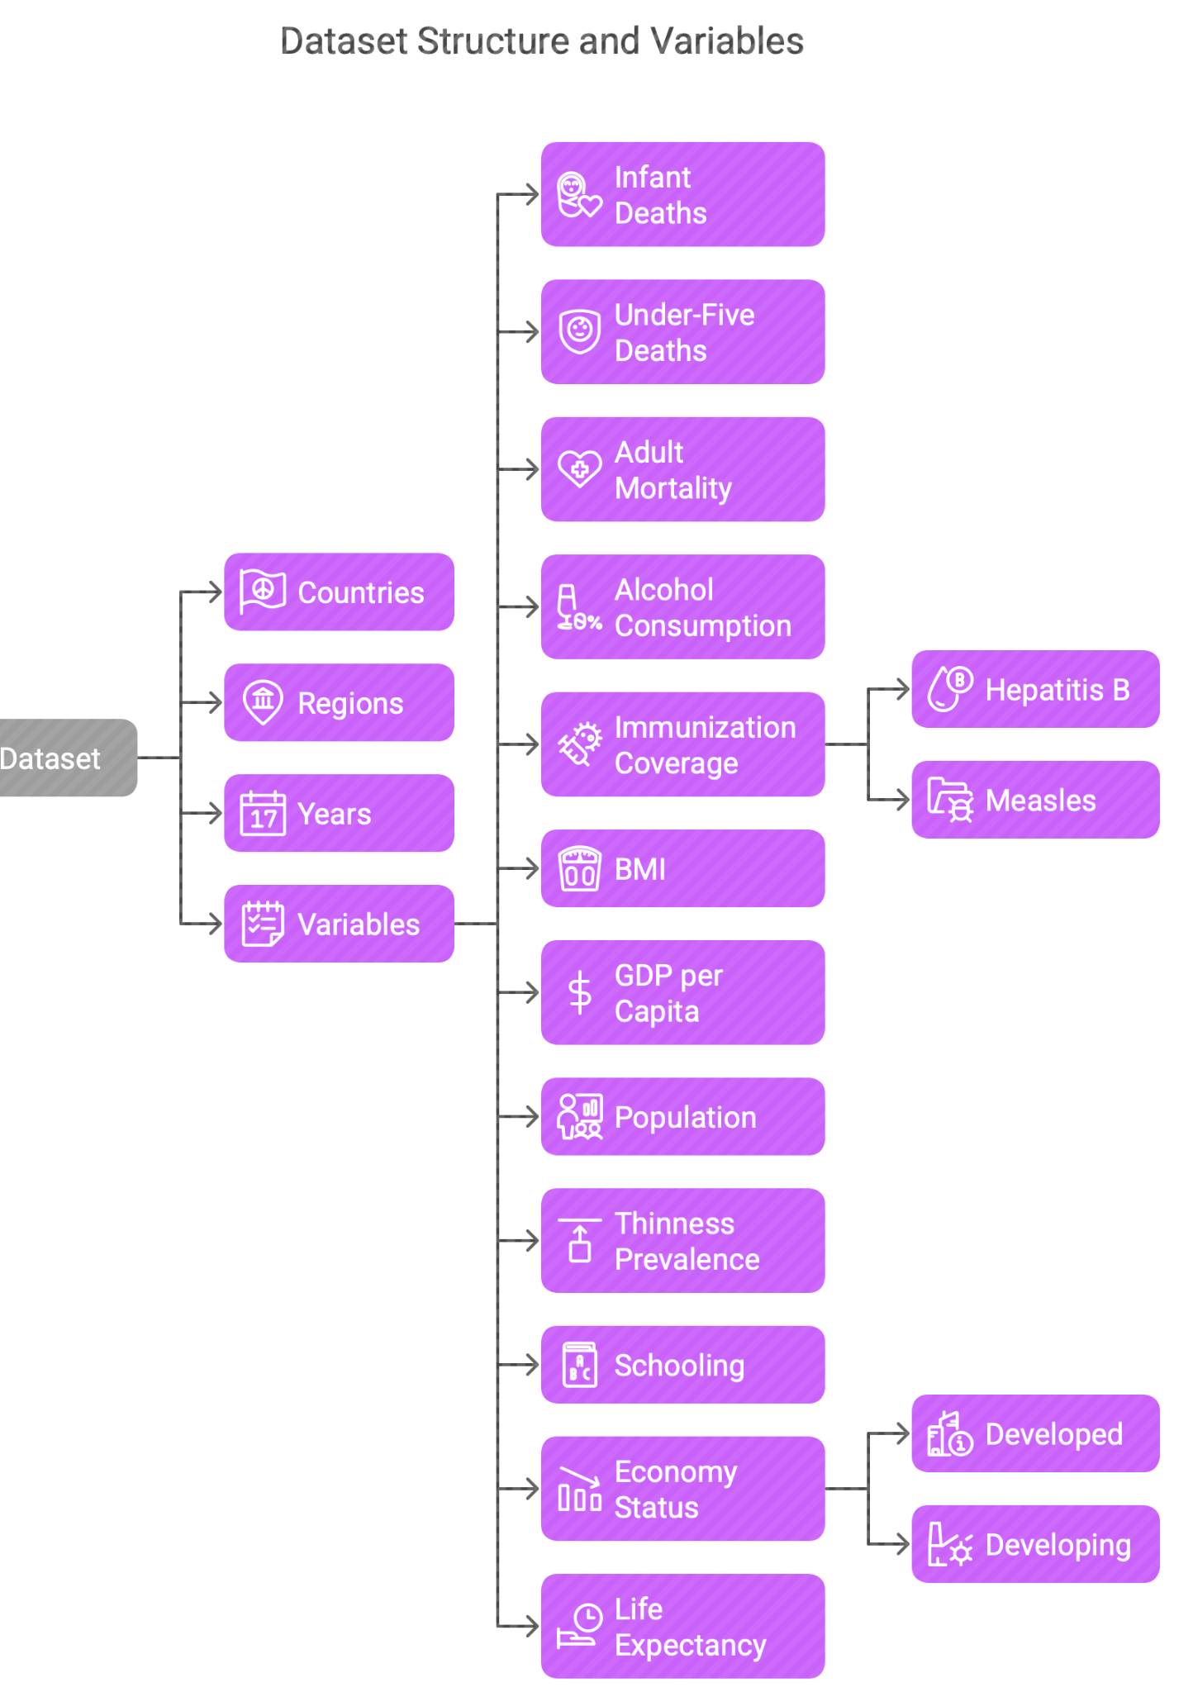
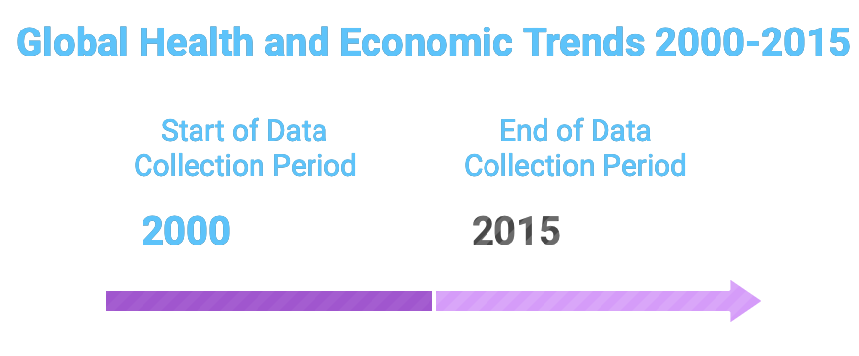
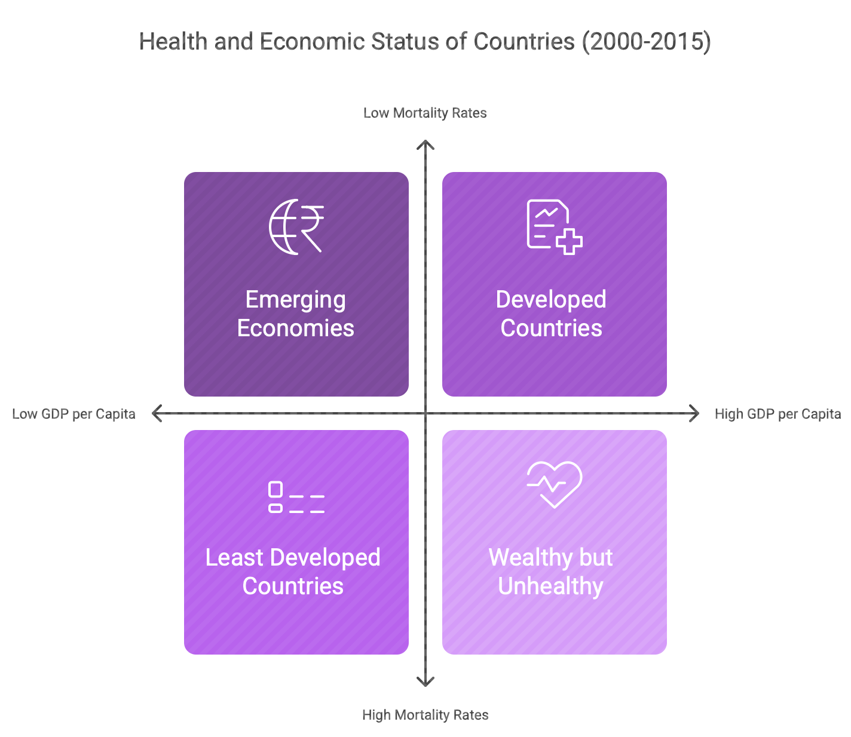

A Brief Overview about the Dataset

Slide 3
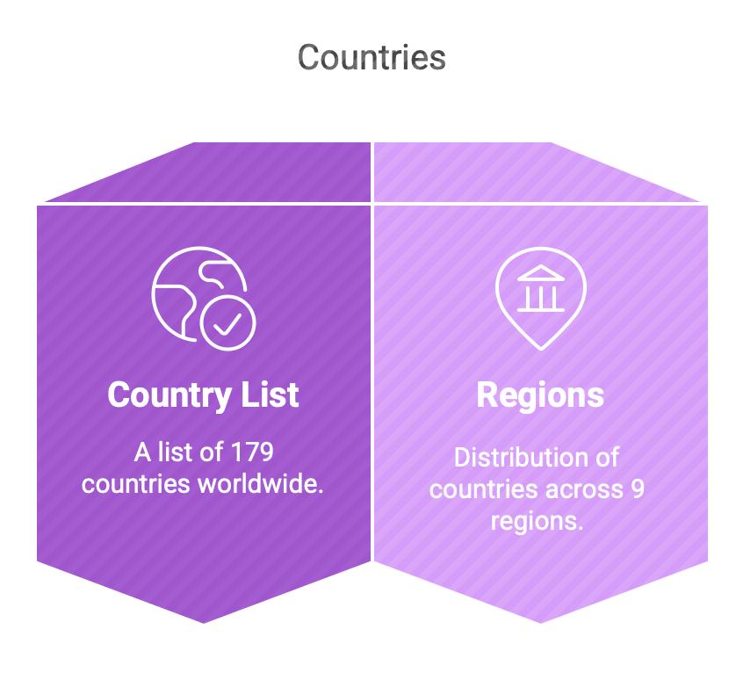
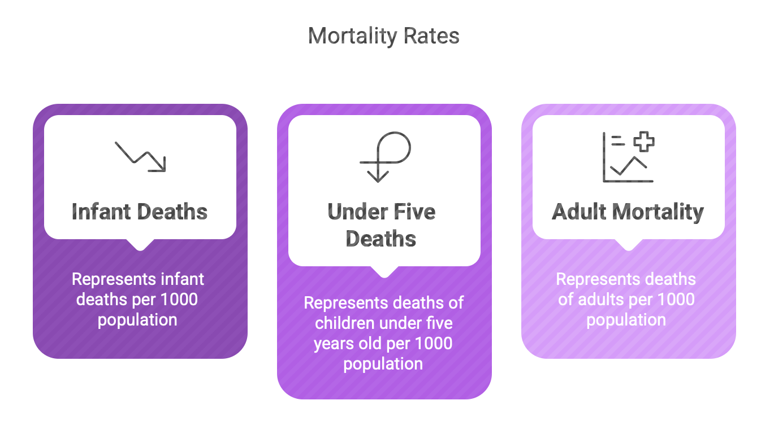
Understanding the data

Slide 4
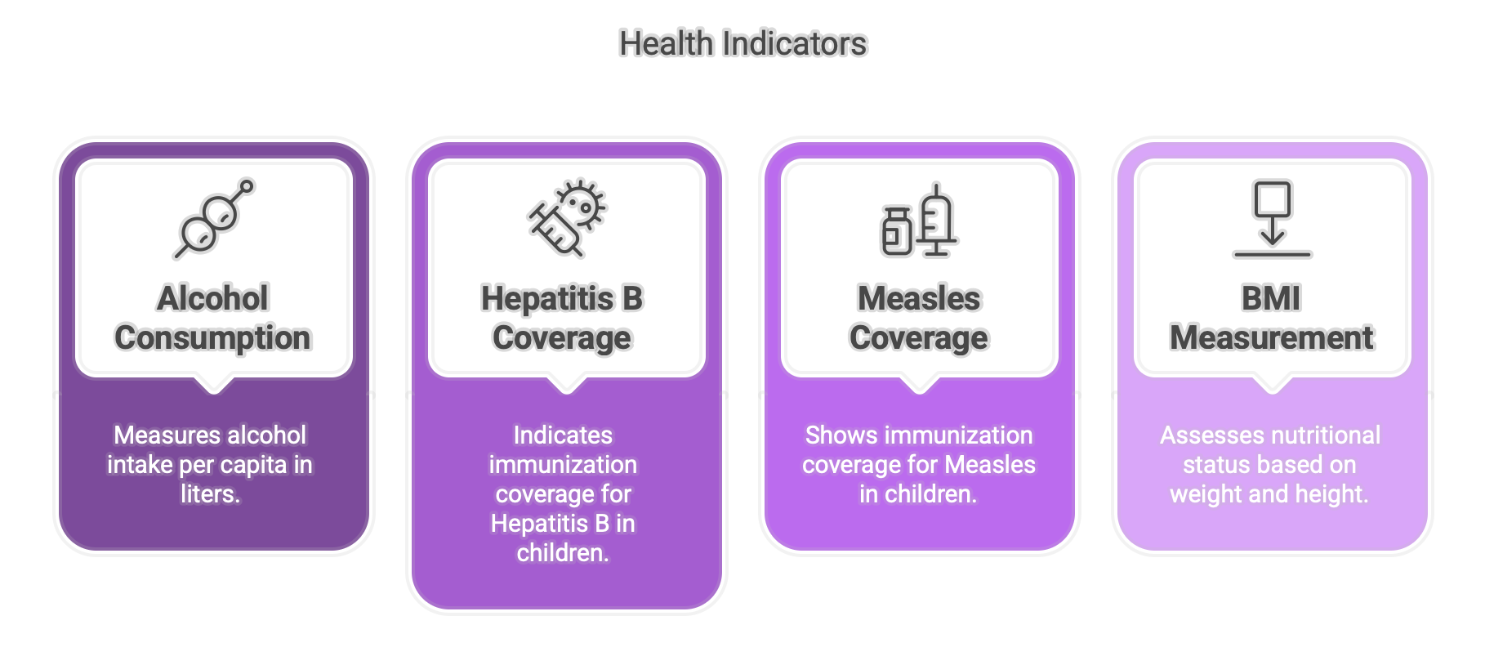
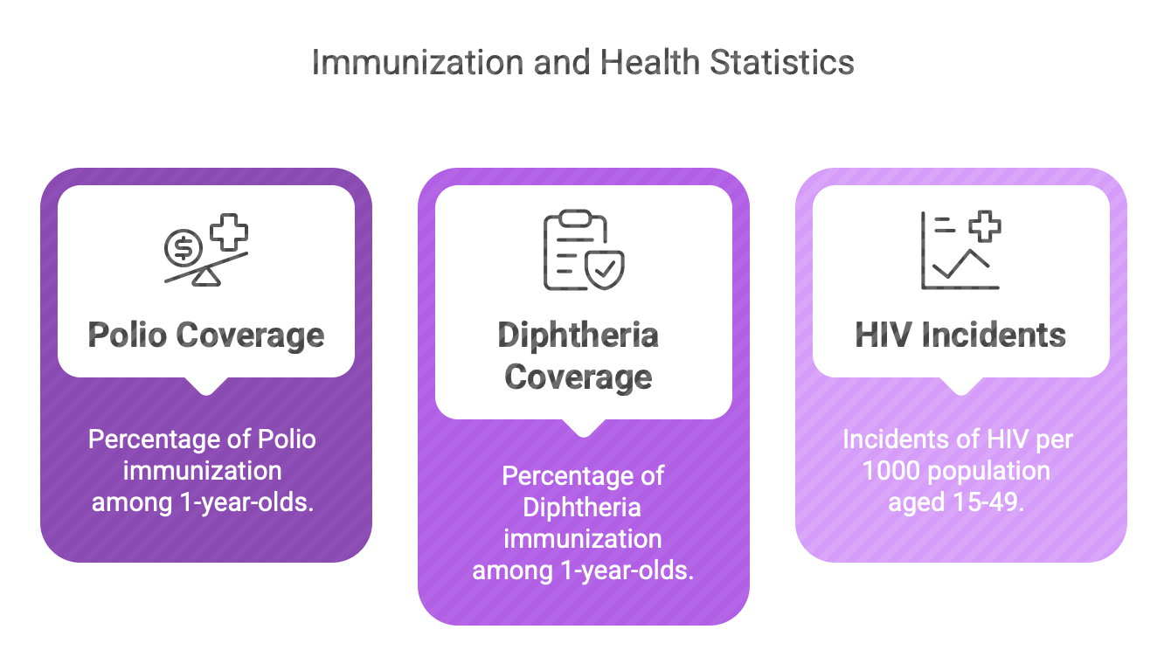
Understanding the data

Slide 5
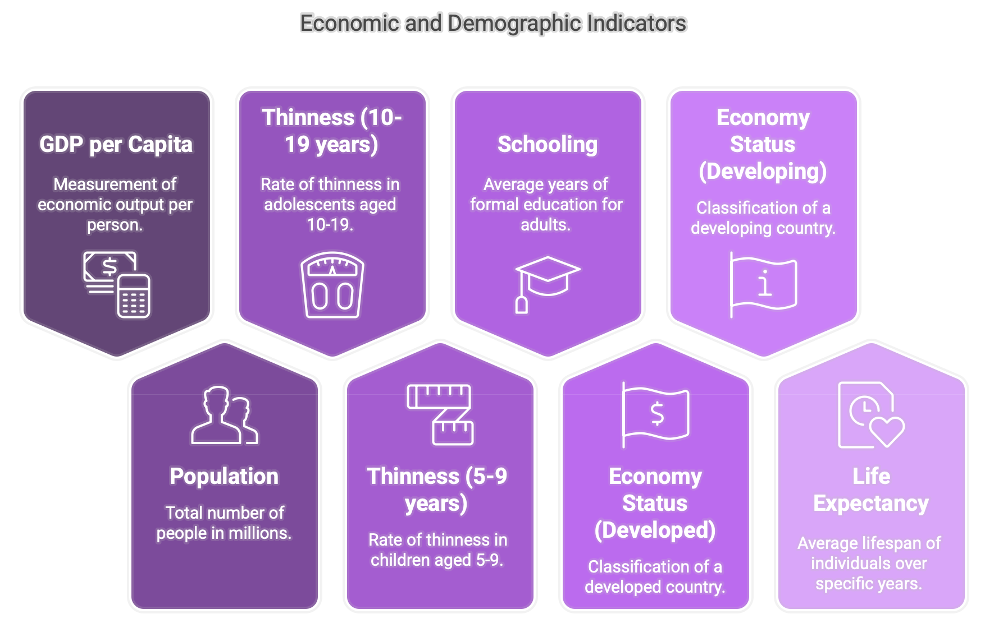
Understanding the data

Slide 6
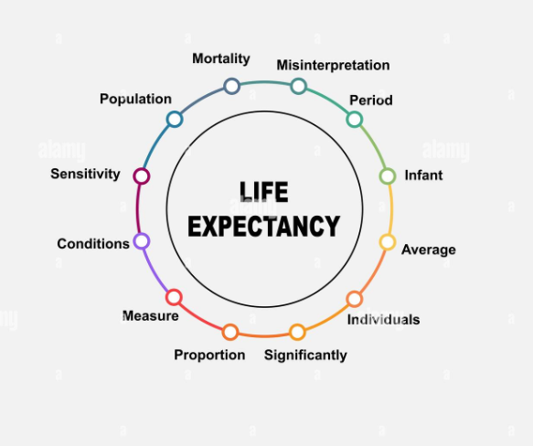
Why Life Expectancy?
A key indicator of overall health and quality of life
Reflects nutrition, healthcare, sanitation, income, and education
Shows how well nations support health and longevity
Links social, economic, and health-related factors globally

Slide 7
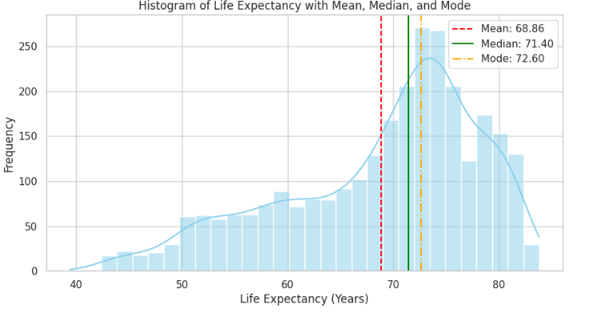
Histogram of Life Expectancy
Vs Frequency
Majority of countries fall between 65 – 80 years
Mean year is 68.86 years
Distribution is slightly left-skewed (more low outliers)
Peak around 70–75 years shows global concentration

Slide 8
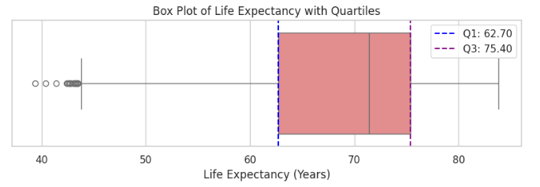
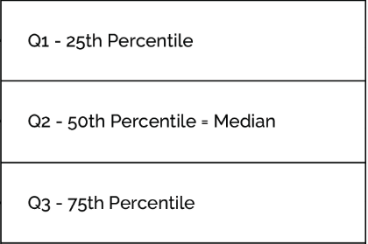
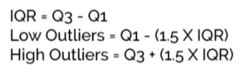
Box Plot of Life Expectancy
Majority of countries fall between 65–80 years
Median life expectancy ≈ 68.86 years
Boxplot shows a few low-end outliers
Box shifted right → confirms left-skew

Slide 9
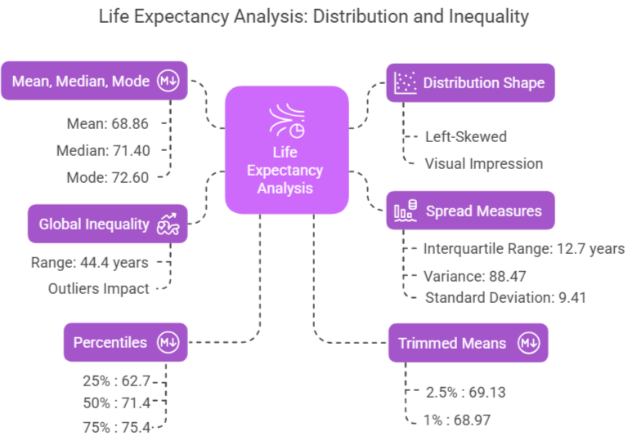
Numerical Calculations and Comparison

Slide 10

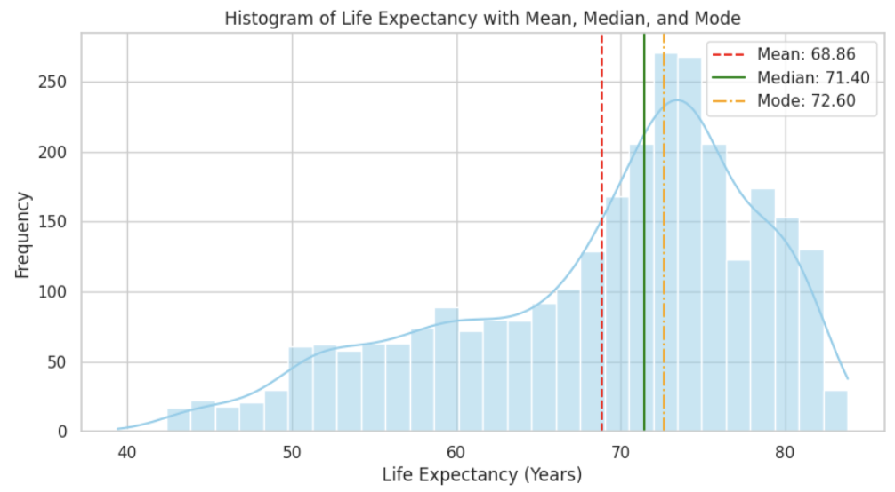
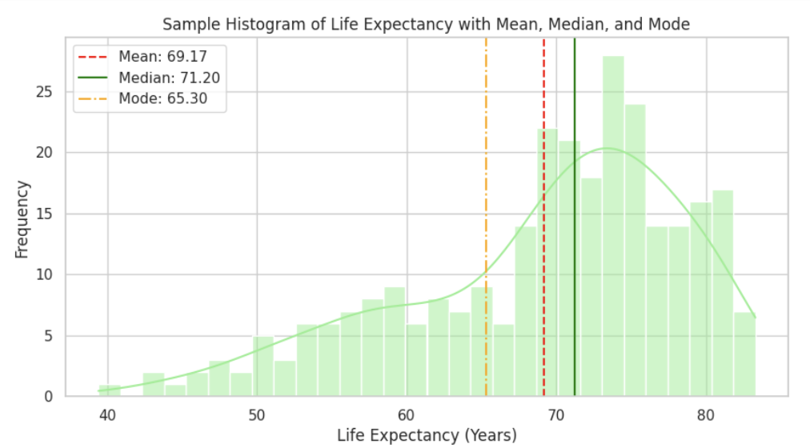
Comparison between Original and Sample (10%) Data
Original
10% Data
From the sample of 286 observations (10%), the mean life expectancy is 69.17 years, and the median is 71.20 years, both close to the population values of 68.86 and 71.40, respectively. However, the sample mode is 65.30 years, differing notably from the population mode of 72.60. This reflects a key aspect of random sampling—while mean and median remain stable in larger samples, the mode can vary based on frequently selected values.
The IQR (6.75 vs. 7.10), standard deviation (6.14 vs. 6.39), and range (38.80 vs. 41.20) are similar in scale but show slight variability due to the smaller sample size. The histogram and boxplot maintain the left-skewed distribution of the full dataset, with fewer low-end outliers. These results confirm that the sample retains key statistical characteristics, making it representative, though minor differences in mode, variance, and KDE
The histogram of life expectancy is left-skewed in both datasets.
The full dataset has a mean of 68.86 years and a median of 71.40 years, while the 10% sample has a mean of 69.17 years and a median of 71.20 years, showing minimal deviation. The mode shifts from 72.60 years in the full dataset to 65.30 years in the sample due to random selection. The Kernel Density Estimate (KDE) confirms that the sample retains the overall distribution shape.

Slide 11
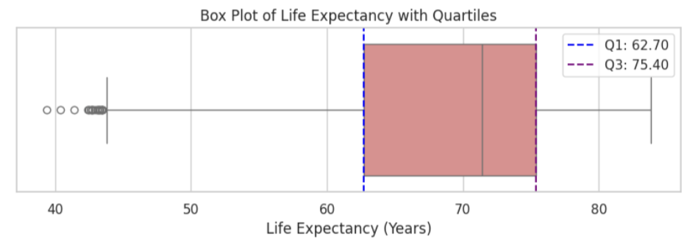
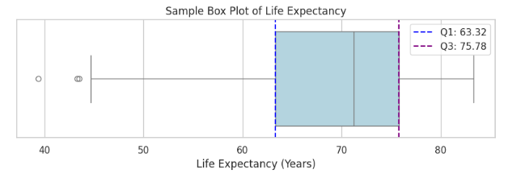
Comparison between Original and Sample (10%) Data
Original
10% Data
The box plot shows similar spread and variability between datasets.
The first quartile (Q1) is 62.70 years in the full dataset and 63.32 years in the sample, while the third quartile (Q3) is 75.40 years and 75.78 years, respectively. The interquartile range (IQR) remains stable at 12.70 years (full) and 12.46 years (sample). The full dataset contains more low-end outliers, while the sample captures fewer due to its size. Despite minor variations, the sample preserves the original dataset’s key statistical properties.

Slide 12
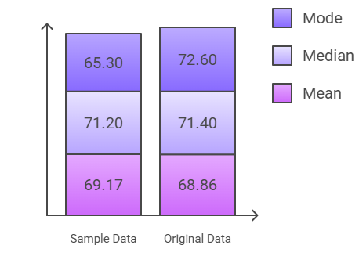
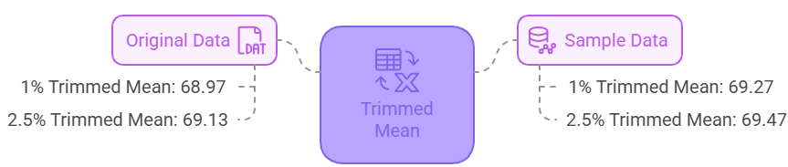
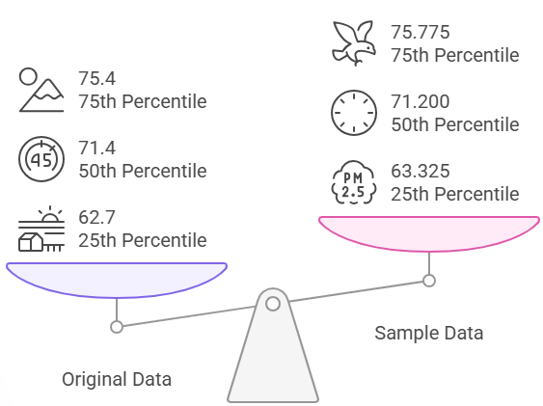
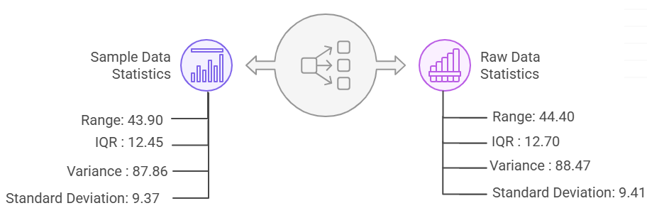
Numerical Finding Analysis

Slide 13
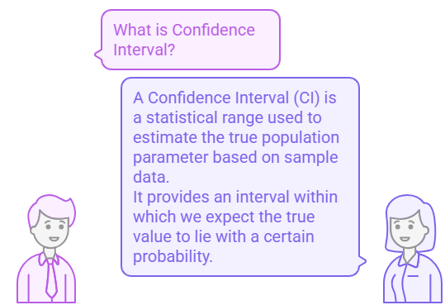
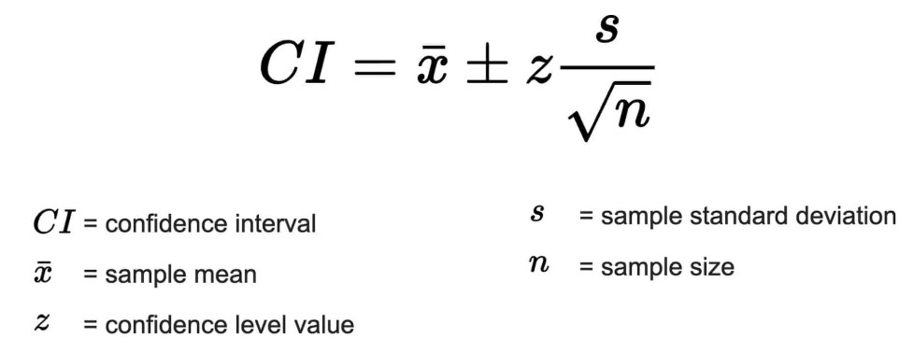
Hypothesis Testing
WHAT IS CONFIDENCE INTERVAL ?

Slide 14
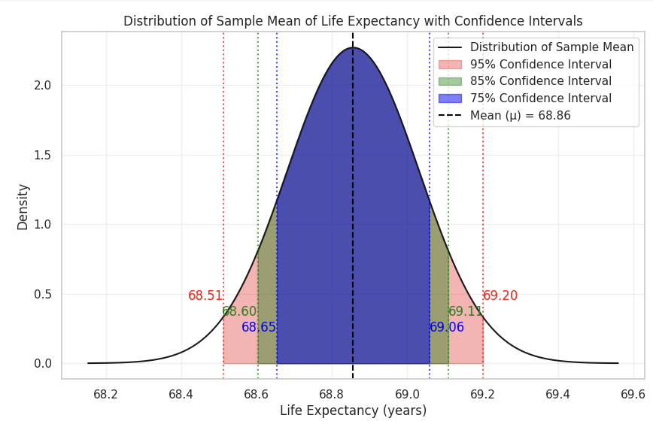
Constructing Confidence Interval
This plot demonstrates how confidence intervals work in estimating the true mean life expectancy based on sample data. The shaded regions show different levels of certainty (from 75% to 95%) about where the true mean lies. The more confident you want to be, the wider the interval needs to be.

Slide 15
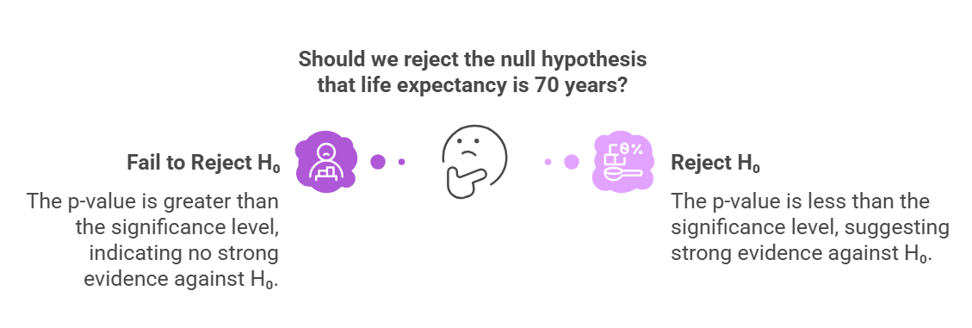
Hypothesis Testing

Slide 16
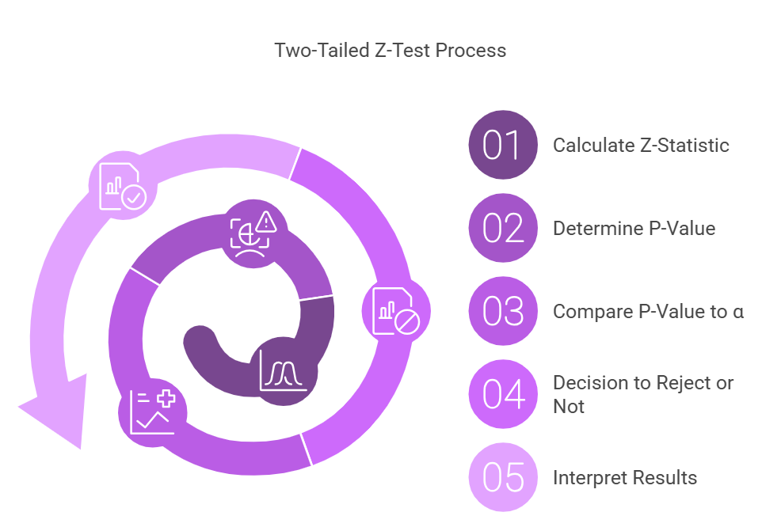
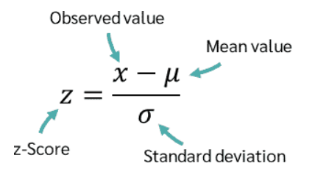
Hypothesis Testing
Hypothesis Testing

Slide 17
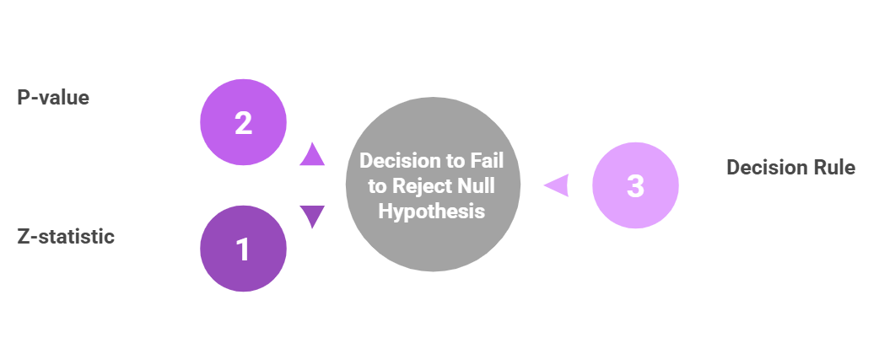

Hypothesis Testing
Hypothesis Testing
0.1365
As P-Value is not less than α (0.05)
So we fail to reject the null hypothesis.
-1.4890

Slide 18
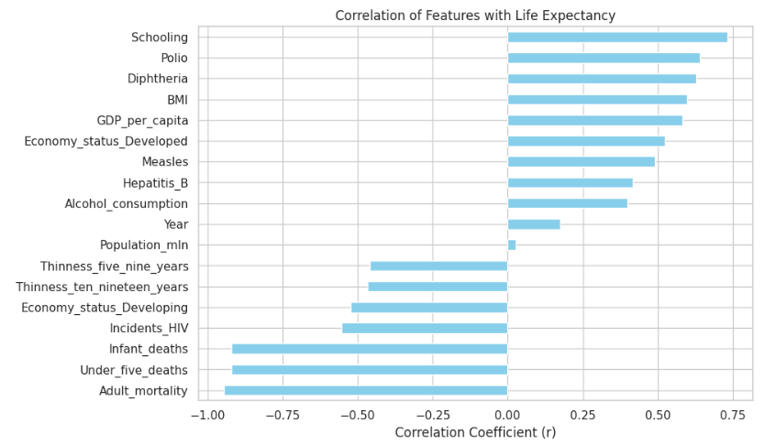
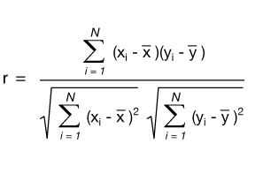
Correlation of Life Expectancy with All Other Columns
Positive Correlation -When one variable increases, the other also increases.
Negative Correlation -When one variable increases, the other decreases.

Slide 19

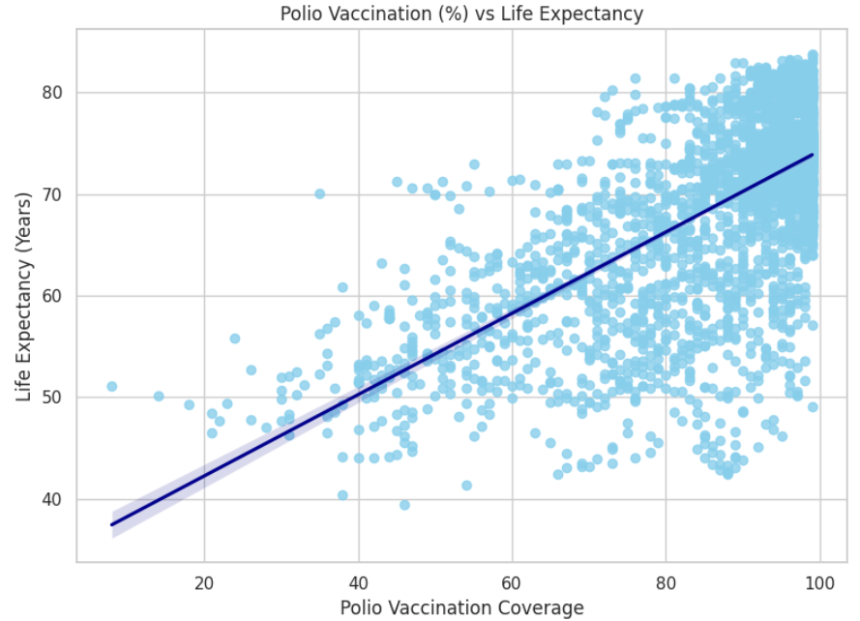


Polio Vaccination vs Life Expectancy
Strong positive correlation: r = 0.6412
R² = 0.4112: Polio coverage explains ~41% of variance in life expectancy
Vaccines reduce preventable diseases, boosting public health.
Emphasizes importance of immunization programs globally.

Slide 20
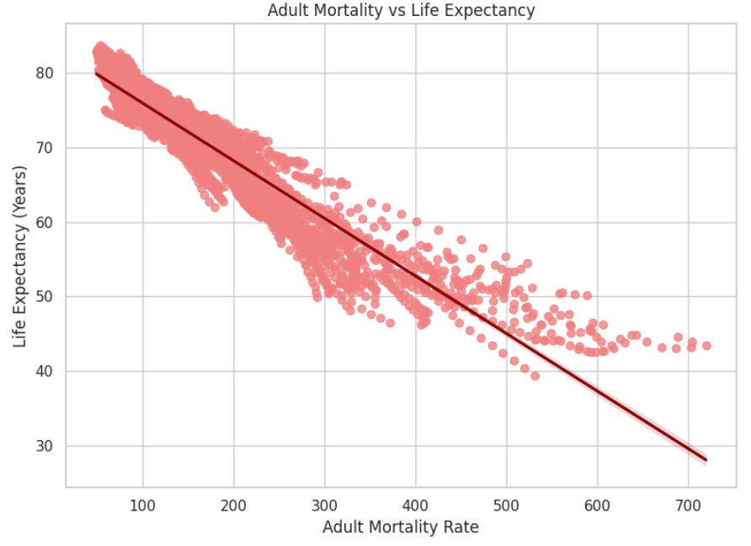
Adult Mortality vs Life Expectancy
Very strong negative correlation: r = -0.9454
R² = 0.89: Explains 89% of life expectancy variance
Reflects healthcare quality, disease burden, and socio-economic conditions
Key indicator of adult health and survival impact

Slide 21
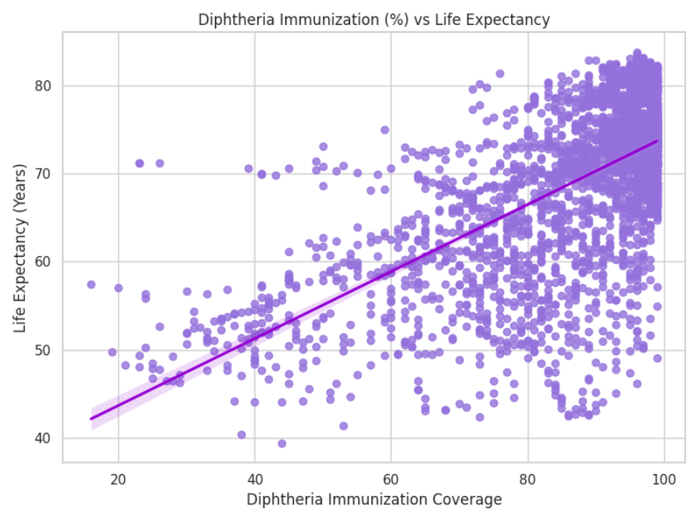
Diphtheria Immunization vs Life Expectancy
Strong positive correlation: r = 0.6275
R² = 0.39: Explains 39% of life expectancy variance.
Consistent pattern across regions supports global relevance
Highlights the impact of childhood vaccines on reducing mortality

Slide 22
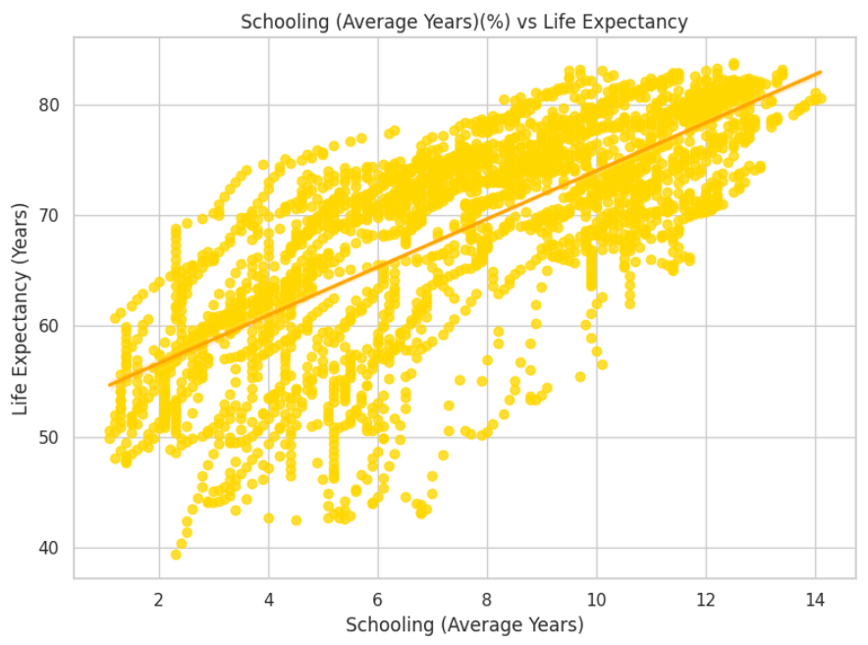
Schooling vs Life Expectancy
Strong positive correlation: r = 0.7325 (highest in dataset)
R² = 0.54: Schooling explains 54% of life expectancy variance
Education improves health awareness, income, and lifestyle
Highlights education as a long-term health investment

Slide 23
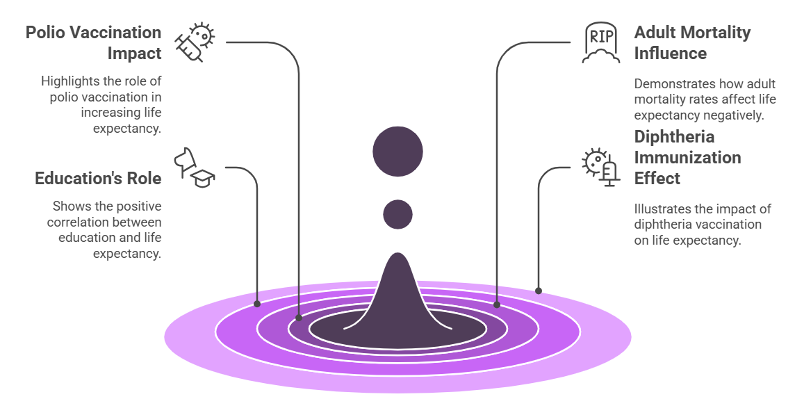
Hypothesis Testing
Factors Influencing Life Expectancy

Slide 24
Hypothesis Testing
References
World Health Organization. (2024). Global Health Observatory Data. Retrieved from https://www.who.int/data/gho
United Nations. (n.d.). UN Data. Retrieved from https://data.un.org
The Pandas Development Team. (n.d.). Pandas documentation. Retrieved from https://pandas.pydata.org
The Seaborn Development Team(n.d.). Seaborn: Statistical data visualization. Retrieved from https://seaborn.pydata.org
Matplotlib documentation. Retrieved from https://matplotlib.org
University of Illinois Urbana-Champaign. (n.d.). Exploratory data analysis: Quartiles and box plots. Retrieved from https://discovery.cs.illinois.edu/learn/Exploratory-Data-Analysis/Quartiles-and-Box-Plots/
Life expectancy WHO (updated) (2023). [Data set]. Kaggle. Retrieved from https://www.kaggle.com/datasets/lashagoch/life-expectancy-who-updated

Slide 25
THANK YOU

